Slide 1
Happy Tuesday ☺
You will need your PPC notes and something to write with today.
HW: Work on your Unit I Outside Work and Flashcards (check for Chapter 1 and 2 on Thursday)
Reminder – you need to print the second packet for your Unit I Outside Work…

Slide 2
Let’s Review
What is a trade-off?
What is scarcity?
What is an opportunity cost?
What are the four factors of production?
How do nations explain a “guns and butter” decision? (employing resources for one product over another)

Slide 3
Production Possibilities Curve
Illustrating Scarcity, Opportunity Cost, and Efficiency

Slide 4
Production Possibilities Curve (Frontier)
PPC(F) - The boundary between the combinations of goods and services that can be produced and the combinations that cannot be produced, given the available factors of production and the state of technology.
The PPC(F) is a valuable tool for illustrating the effects of scarcity and its consequences
The PPC(F) puts three features of production possibilities in sharp focus:
1. Scarcity – Attainable and Unattainable
2. Efficiency (maximizing output)
3. Opportunity Costs/Trade-offs

Slide 5
Mr. Clifford

Slide 6
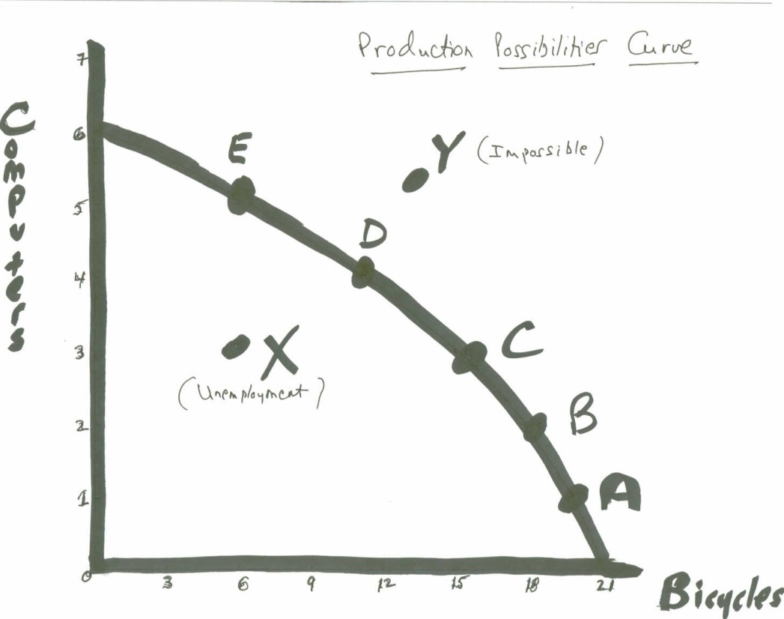
Law of Increasing Opportunity Costs
The curve indicates that goods do not change in equal proportions. As the production of one good goes up and more resources are used to create that good, the rate of production of the other decreases by an increasing rate. This is the Law of Increasing Costs. Rarely there might be a straight line.

Slide 7
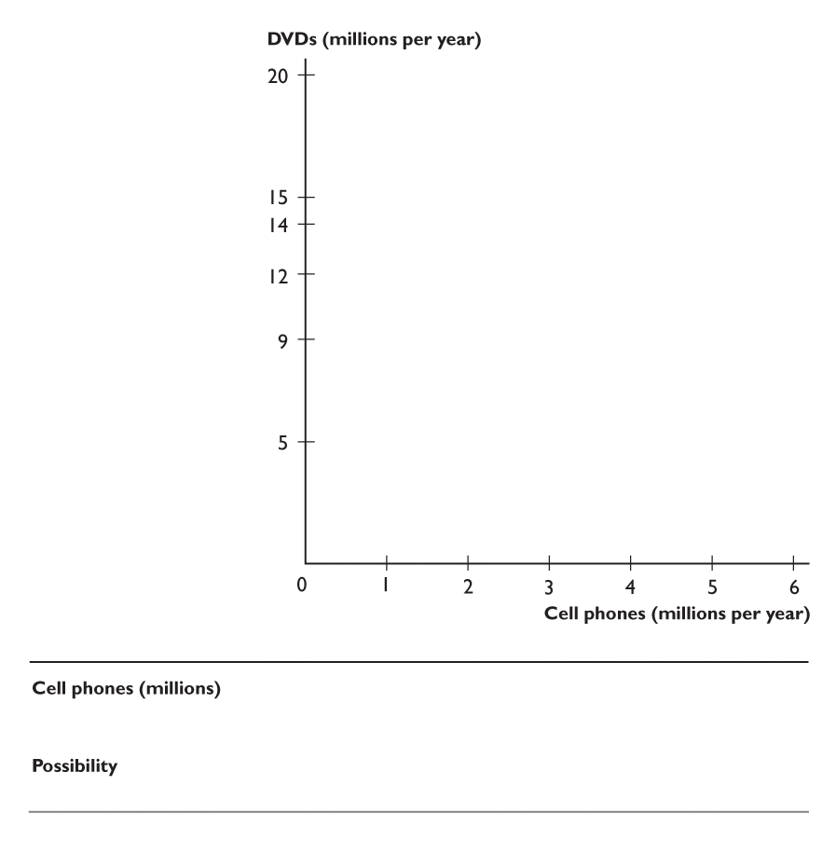
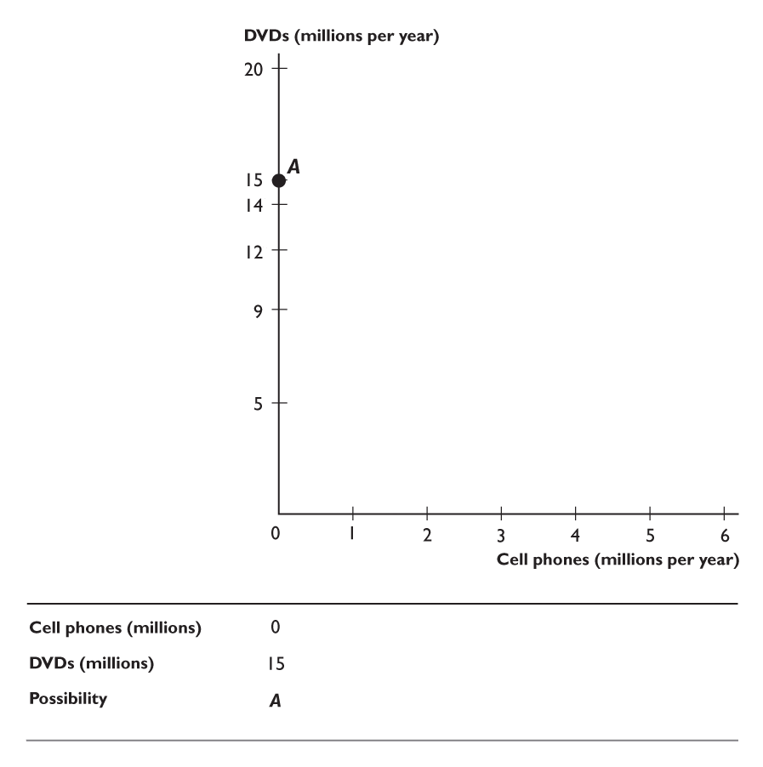
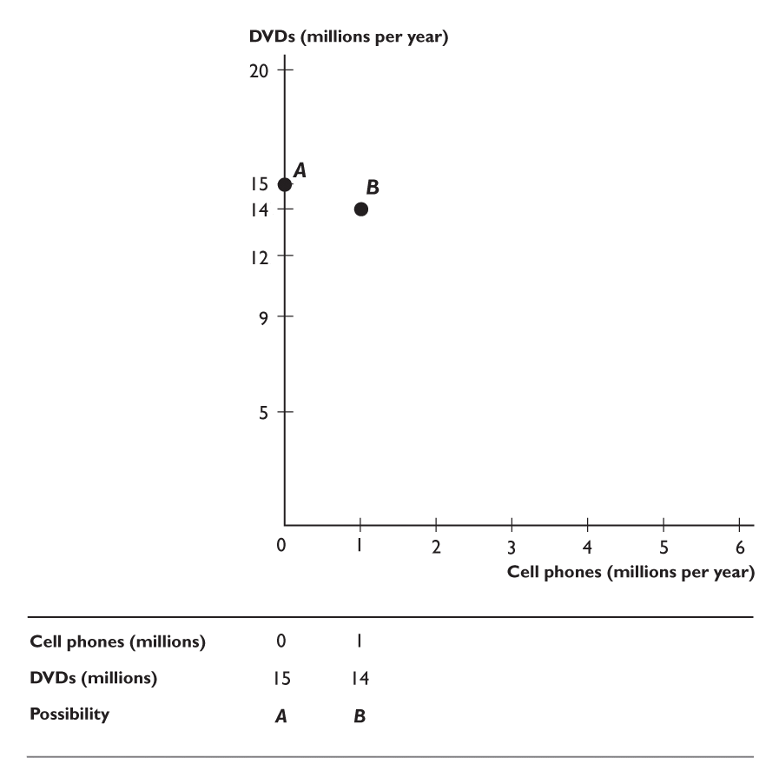
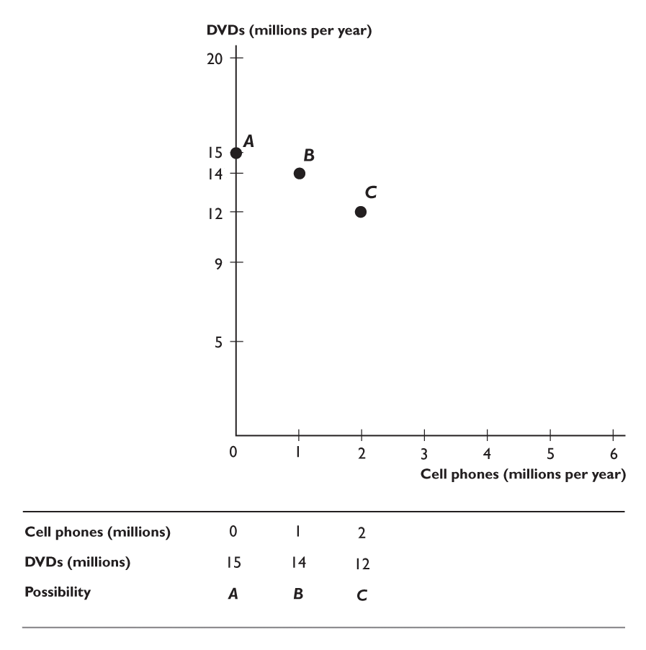
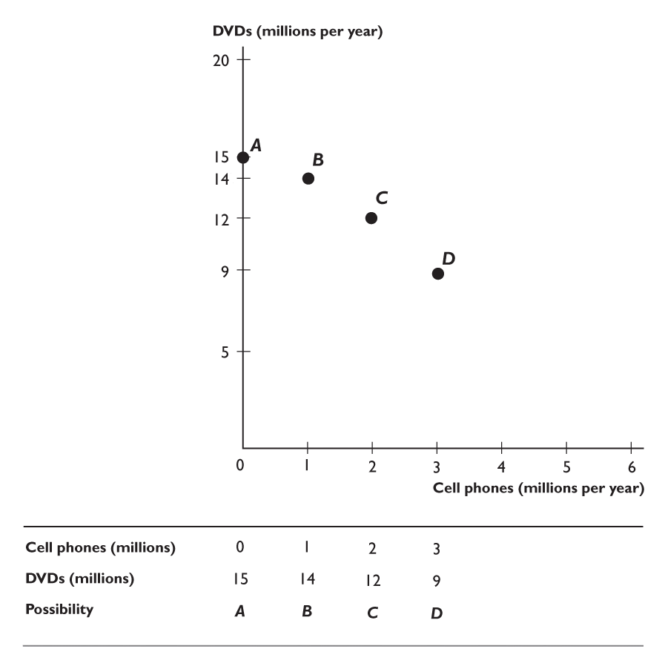
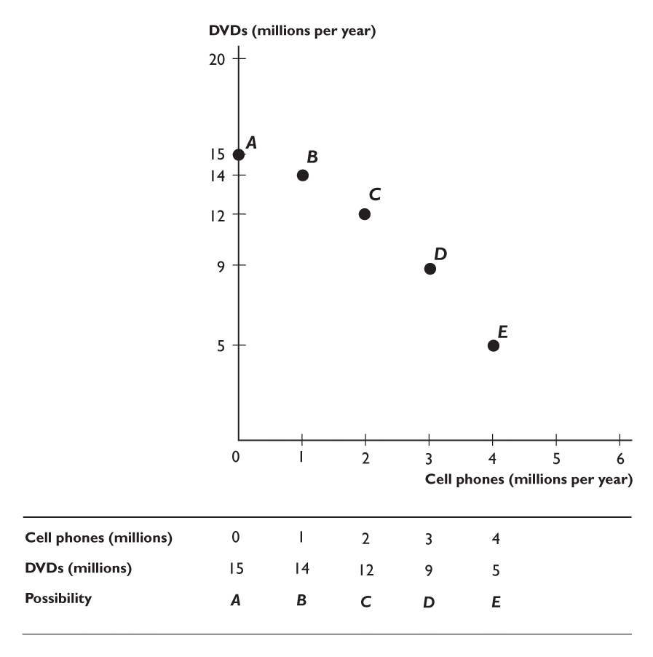
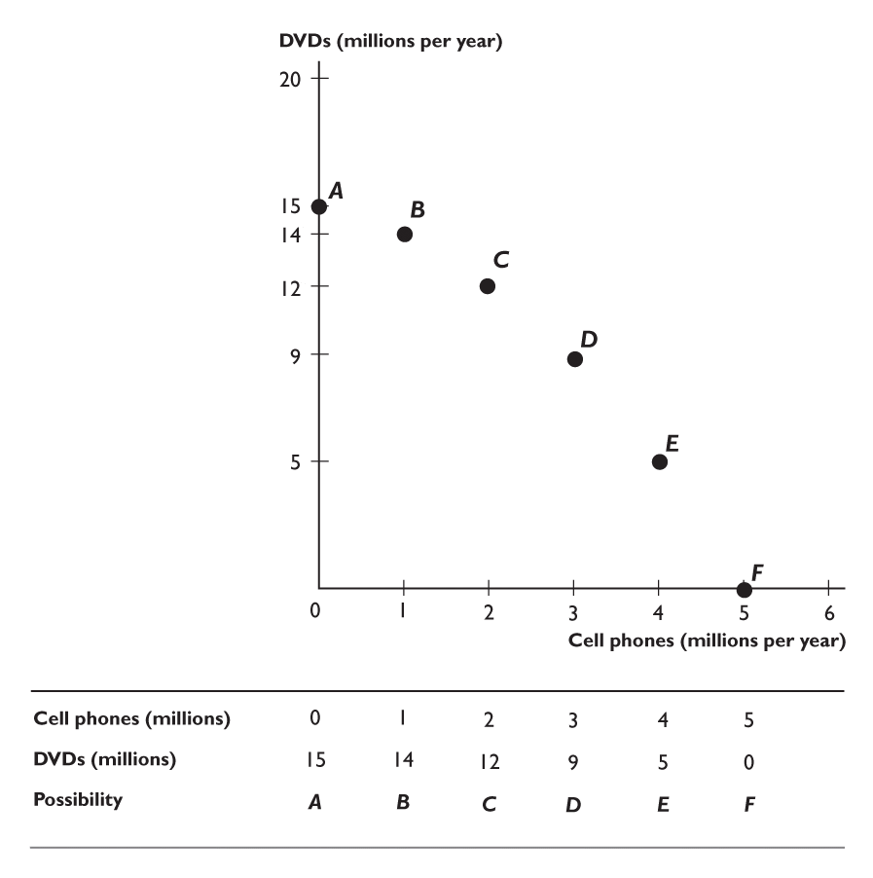
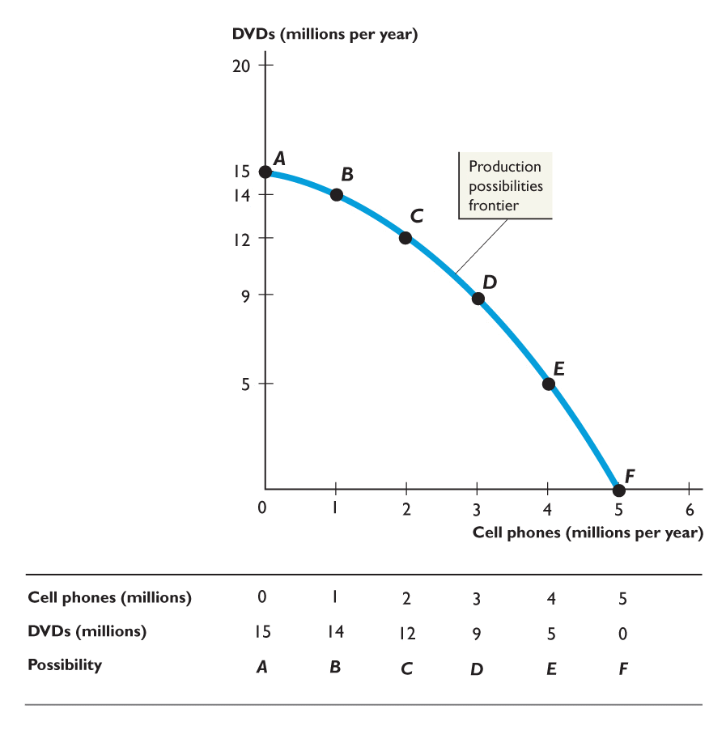
PRODUCTION POSSIBILITIES Cell Phones and DVDs
● Remember that the PPC shows the different combinations of products that can be produced with a specific set of resources, assuming we are using all of our resources.
The figure shows the PPC(F) for cell phones and DVDs.
●Each point on the graph represents a column of the table (production possibility)
●The line through the points is the PPC(F).
Notes:
Get the students to realize how useful even a simple economic model, such as the PPC(F) model, is for helping us understand and interpret important political events in history. For instance, the PPC(F) model can be used to analyze real-world events such as an “Arms Race” between nations. Draw a PPC(F) for military goods and civilian goods production. Then draw another PPC(F) for a country that is about twice the size of the first, but with the same degree of concavity as the PPC(F) for the first country. Now assume that each country considers the other as a mortal “enemy,” and that they engage in a costly arms race. Each country picks a point on the PPC(F) that produces an equal level of military output in absolute terms.
What would happen if the larger country decided to increase military production? Emphasize that while the distance on the military output axis at the point of production is equal for both countries, the resulting distance on the civilian output axis is (by definition) a smaller quantity for the smaller country. The large country can create significant economic and political pressures on the government of the small country by forcing the small country to match the increase in military production. The PPC(F) reveals how much more additional civilian output is forgone by the citizens of the small economy relative to the citizens of the larger economy. Emphasize also that the opportunity cost of civilian goods is higher for the smaller country.
What were the economic repercussions of the Cold War? History and political science majors quickly perceive that these two PPC(F) models reflect the Cold War relationship between the United States and the U.S.S.R. during the early 1980s. The Reagan administration increased U.S. military expenditures during the early 1980s to a post-Vietnam War peak of 6.6 percent of GDP (as compared to about 3.5 percent of GDP in the late 1990s). Many experts agree that this strategy contributed to the many political and economic pressures that ultimately lead to the dissolution of the U.S.S.R.

Slide 8
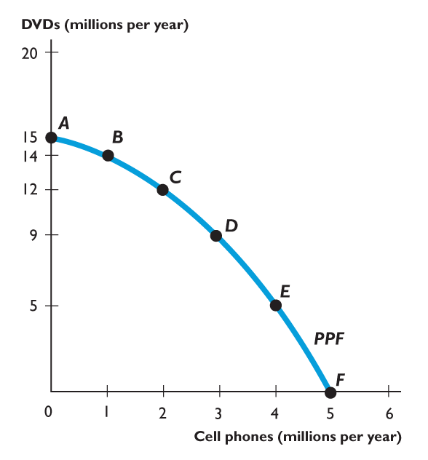
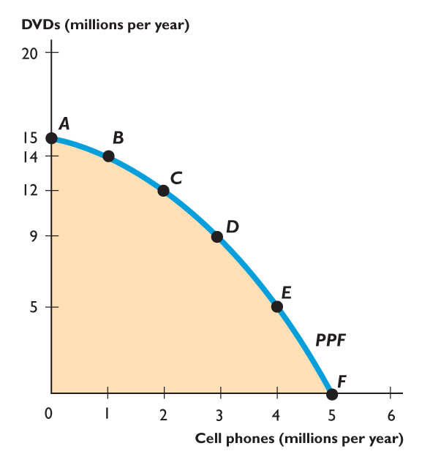
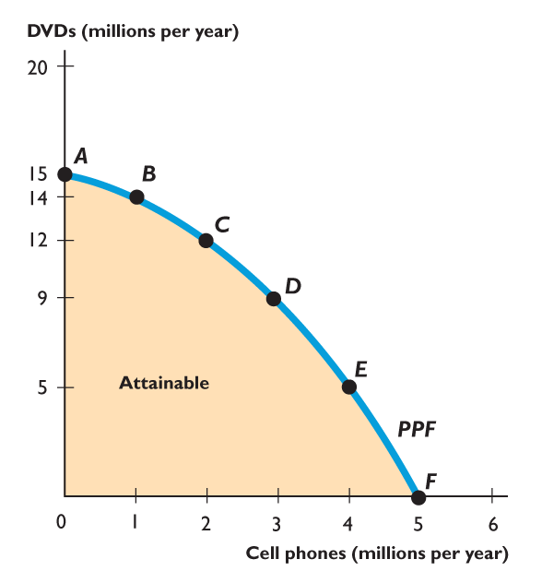
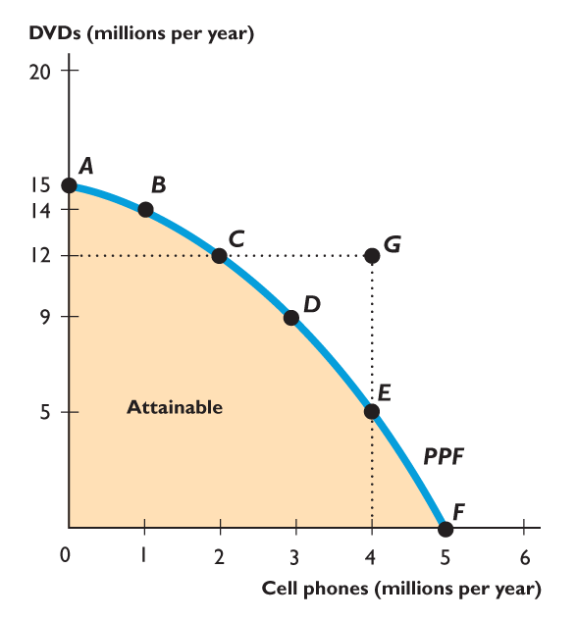
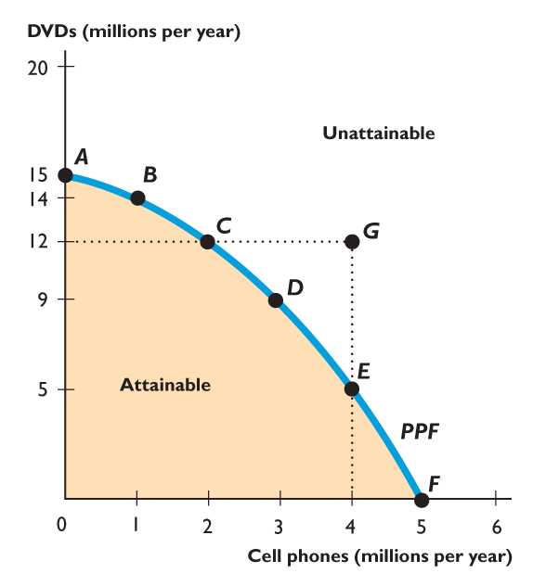
ATTAINABLE, UNATTAINABLE, EFFICIENCY
●We can produce at any point inside the PPC(F) – this is considered attainable, but inefficient. (underutilization)
●Points A-F represent efficiency and are attainable. (the line)
●We cannot produce at any point outside the PPC(F) such as point G – unattainable. (don’t have enough resources)
●The PPC(F) separates attainable combinations from unattainable combinations.

Slide 9
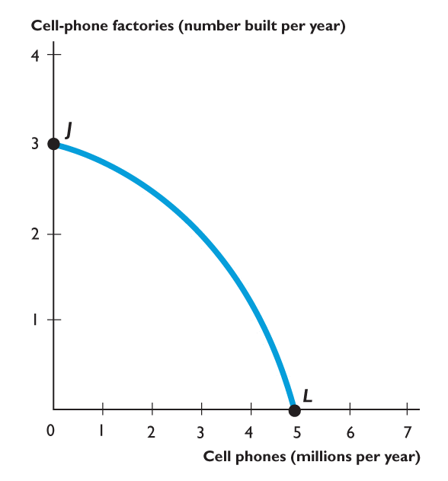
Economic Growth
The PPC(F) can also illustrate economic growth.
This growth can be demonstrated in overall economic growth (the entire PPC(F) shifts outward) or growth in a specific area of the economy.
If we produce at point J, we produce only cell-phone factories and no cell phones.
If we produce at point L, we produce cell phones and no cell-phone factories.

Slide 10
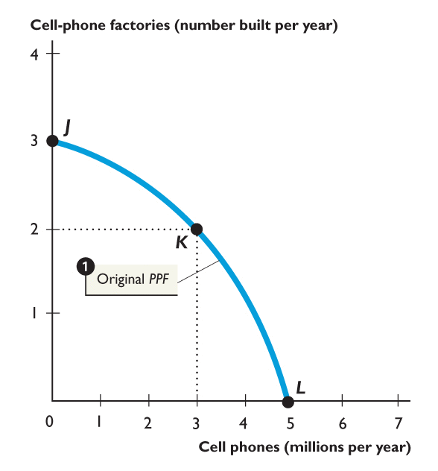
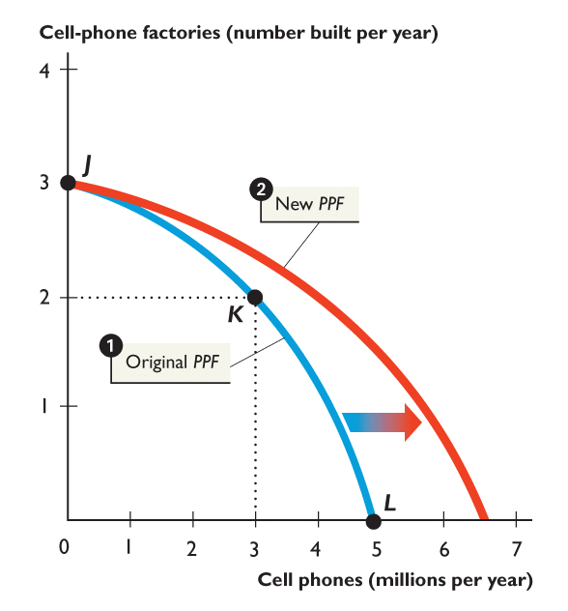
Economic Growth, cont’d.
Scenario: Consider in previous years we only produced cell phones (point L on PPC(F))
1. We cut production of cell phones to 3 million this year, How many cell phone factories can we produce? Opportunity Cost? What happens to PPC(F) the following year?
2. The next year, our PPC(F) shifts outward for cell phones. WHY?
Answer: We have more capital

Slide 11
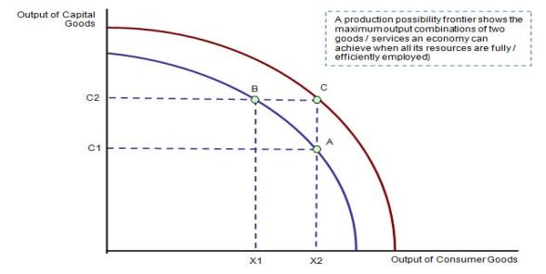
Economic Growth, cont’d
The PPC(F) also illustrates growth to the overall economy. This is demonstrated by shifting the entire PPC(F) outward, and allows for more production to occur in all facets of economy. (More technology, capital, population, land)
A inward shift of the PPC indicates a decline in production. (Natural disaster, loss of land, deaths)
Scenarios:
A new fossil fuel is discovered that allows for greater productivity in all areas of the economy.
A government invades our nation and claims 1/3 of our land as its territory.
A new technology is created allowing for more efficient manufacturing
An outbreak of malaria kills 40% of the population.

Slide 13
Grab and partner….
And let’s practice!
Each partner should create their own answer sheet for the PPC Practice Session.
We will go over the answers together.

